Slide 1
Single-Cell Perturbation
Analysis Using Machine Learning
Francis Boabang

Slide 2

Background
Predicting the outcome of genetic perturbations (e.g., CRISPR knockouts) is key to understanding cell differentiation and disease response.
Perturbation datasets (Perturb-seq, Mixscape)
enable modeling the causal mapping between perturbations and transcriptional outcomes.
However, current regression-based models often assume linearity, missing complex regulatory dynamics.
Most existing models rely exclusively on either in silico perturbation data or experimental perturbation data, but rarely integrate both limiting their ability to generalize and validate predictions across simulated and real biological contexts.

Slide 3
Gaps in the Research
Known:
Linear models (LASSO, Elastic Net) identify sparse gene–gene dependencies. Linear models can fail to capture nonlinear gene–gene or protein to protein dependencies or combinatorial perturbations.
Gaussian Process Regression captures limited nonlinearity.
Reinforcement learning (RL) shows promise for modeling dynamic perturbation sequences
Unknown:
The nonlinear extensions such as Gaussian Process regression, graph neural networks, or reinforcement learning frameworks that better represent biological complexity and adaptive perturbation effects however they often get stuck in local optima in the Waddington landscape.
Most existing models rely exclusively on either in silico perturbation data or experimental perturbation data but rarely integrate both limiting their ability to generalize and validate predictions across simulated and real biological contexts. Hence, generalization to out-of-sample experimental perturbations.
Interpretability of perturbation effects across multi-omics layers (RNA, ATAC, ADT) with experimental Validation.
References:
Huynh-Thu, V. A., Irrthum, A., Wehenkel, L., & Geurts, P. (2010). Inferring regulatory networks from expression data using tree-based methods. PLoS ONE, 5(9): e12776.
Marbach, D., Costello, J. C., Küffner, R., Vega, N. M., Prill, R. J., Camacho, D. M., ... & Kellis, M. (2012). Wisdom of crowds for robust gene network inference. Nature Methods, 9(8): 796–804.
Xing, H., & Yau, C. (2025). GPerturb: Gaussian Process Modelling of Single-Cell Perturbation Data. Nature Communications, 16(1): 5423.
Gavriilidis, G. I., et al. (2024). A Mini-review on Perturbation Modelling Across Single-Cell Omic Modalities. Computational and Structural Biotechnology Journal, 23: 1886–1895.

Slide 4
Datasets
Perturb-seq / Mixscape – CRISPR perturbations with transcriptomic readouts for validation.
scRNA-seq / scATAC-seq / CITE-seq – Multi-omic single-cell data.
Simulated GRNs – In-silico perturbation environments for model training.
http://www.perturbase.cn/
https://www.ncbi.nlm.nih.gov/bioproject/?term=cite

Slide 5
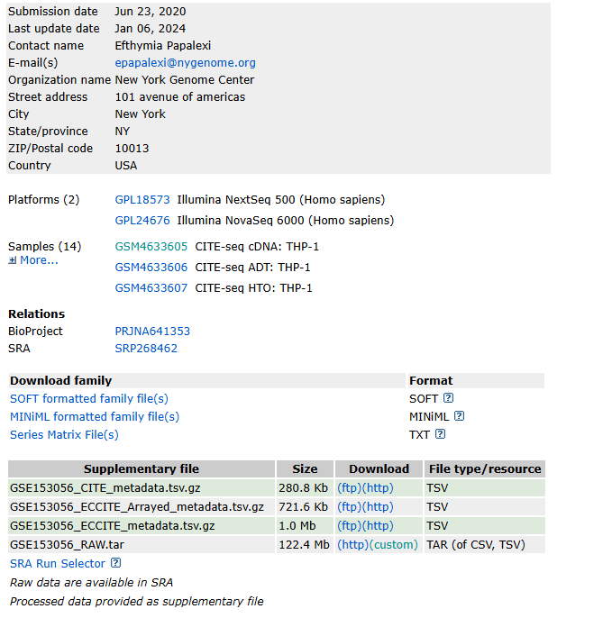
Example
GSE153056_RAW.tar
CITE-seq
Expanded CRISPR-
Compatible CITE-seq
Training plus In-silico
Perturbation
Experimental Validation
https://drive.google.com/file/d/1kj6sNfe_Tib92T1__a-CkNkFFudfbhOt/view?usp=sharing

Slide 6
Using Initialization Strategies to Address Nonlinearity in Developmental Biology
We leverage machine-learning initialization strategies to overcome the inherent nonlinearity in developmental biology, improving the modeling of cell-differentiation trajectories.
Concept: Convex or structured initializations (e.g., sparse regression, trust-region, or pre-trained convex embeddings) provide stable starting points for highly nonlinear optimization landscapes in biological systems.
Goal: To ensure that nonlinear models such as deep or reinforcement-learning frameworks converge toward biologically meaningful minima rather than arbitrary local optima.
Impact: Enhances the fidelity of cell-fate prediction and differentiation modeling, leading to more accurate simulations of lineage commitment and reprogramming dynamics.
Outcome: A unified approach where machine-domain initialization bridges computational optimization and biological interpretability, improving predictive performance in cell differentiation and regenerative modeling.

Slide 7
Proposed Idea 1: Escaping Local Optima in the Waddington Landscape: A Multi-Stage TRPO-PPO Approach for Single-Cell Perturbation Analysis
Boabang, Francis, and Samuel Asante Gyamerah. "Escaping Local Optima in the Waddington Landscape: A Multi-Stage TRPO-PPO Approach for Single-Cell Perturbation Analysis." arXiv preprint arXiv:2510.13018 (2025).

Slide 8
Proposed Idea 2: Convex-Initialized Regression for Nonlinear Gene-Regulatory Modeling
References from Machine Learning Domain
Selesnick, "Sparse Regularization via Convex Analysis," in IEEE Transactions on Signal Processing, vol. 65, no. 17, pp. 4481-4494, 1 Sept.1, 2017
Boabang, Francis. Refining Optimization Methods for Training Machine Learning Models: A Case Study in Robotic Surgical Procedures. Diss. Concordia University, 2024.
Application to Perturbation Analysis: Convex-Initialized Regression for Nonlinear Gene-Regulatory Modeling
Building on Selesnick’s “Sparse Regularization via Convex Analysis” (IEEE TSP, 2017) and Boabang et al. , this work can apply convex-analysis–based initialization to stabilize nonlinear gene-regulatory machine-learning models.
Convex initialization: Begin with a convex sparsity-inducing regression stage (e.g., Elastic Net or LASSO) to estimate key regulator–target dependencies. This yields a stable and interpretable sparse prior.
Nonlinear refinement: The convex solution seeds subsequent nonlinear learners such as Gaussian-process regressors or neural networks capturing higher-order, context-dependent regulatory effects.
Convex Stage Method: Omranian, N., Eloundou-Mbebi, J., Mueller-Roeber, B. et al. Gene regulatory network inference using fused LASSO on multiple data sets, Sci Rep 6, 20533 (2016).
NonConvex Stage method :Xing, H., & Yau, C. (2025). GPerturb: Gaussian Process Modelling of Single-Cell Perturbation Data. Nature Communications, 16(1): 5423.

Slide 9
Proposed Idea 3: Decision Tree-Guided Neural Initialization for Stable Modeling of Gene-Regulatory Networks to improve model generalization performance
Reference from Machine Learning Domain
K. D. Humbird, J. L. Peterson and R. G. Mcclarren, "Deep Neural Network Initialization With Decision Trees," in IEEE Transactions on Neural Networks and Learning Systems, vol. 30, no. 5, pp. 1286-1295, May 2019, doi: 10.1109/TNNLS.2018.2869694.
Application: Decision Tree-Guided Neural Initialization for Stable Modeling of Gene-Regulatory Networks to improve model generalization performance
Convexity Phase Method In Biological Domain: Huynh-Thu, V. A., Irrthum, A., Wehenkel, L., & Geurts, P. (2010). Inferring regulatory networks from expression data using tree-based methods. PLoS ONE, 5(9): e12776.
Nonconvexity Phase Method In Biological Domain: Ahlmann-Eltze, C., Huber, W. & Anders, S. Deep-learning-based gene perturbation effect prediction does not yet outperform simple linear baselines. Nat Methods 22

Slide 10
Expected Impact
Establishes digital twin models for predictive cellular perturbation.
Bridges regression inference and policy optimization frameworks.
Facilitates future wet-lab validation of in silico predictions.
Supports regenerative medicine and therapeutic design via perturbation-aware modeling.

